Slide 1

Secure distroless OCI images
via YAML
Viktor Bonev VMware Carbon Black
BSides Sofia 19 March 2023

Slide 2
WHOA!
This can be the part of the presentation where you introduce yourself…

Slide 3
TABLE OF CONTENTS
01
02
03
04
05
06
What is OCI?
OCI Isolation 101
Exploit showcases
Definition & brainstorm
cgroups, fs, chroot and ns
Brief overview of key moments
Alpine
Distroless
Project Myklon
Loved by many, hated by even more
What makes a distroless image?
Our approach to solve the issues

Slide 4
01
OCI
Open Container Initiative

Slide 5





INTRODUCTION
JSON
configuration
OCI
Kubernetes
Notes:
The Open Container Initiative (OCI) is a Linux Foundation project, started in June 2015 by Docker, to design open standards for operating-system-level virtualization (software containers), most importantly Linux containers.
There are currently two specifications in development and in use: Runtime Specification (runtime-spec) and the Image Specification (image-spec).
OCI develops runc, a container runtime that implements their specification and serves as a basis for other higher-level tools. runc was first released in July 2015 as version 0.0.1.

Slide 6
—SOME PRESENTER
“By no means those are magical services, which are unique.”

Slide 7

How it works?
Understanding how those pieces of software leverage Linux kernel system components and attributes is the key.

Slide 8
02
OCI Isolation
Crash-course 101

Slide 9
cgroups (control groups)
Kernel feature for resource isolation (cpu, memory, disk, network)
$ /sys/fs/cgroup
→ You can create your own cgroup and set min/max levels for certain hardware feature
# Containerd/cri-o leverages this via flags
$ podman run –d --rm -m 256m nginx:latest $ /sys/fs/cgroup/memory.max/podman/<CONTAINER_SHA>/memory.limit_in_bytes
268435456

Slide 10
namespaces I
Kernel feature for resource partioning into set of processes.
cgroups limits the resource usage, namespaces limits the resource a process can ‘see’.
$ lsns
podman run -it --rm nginx:latest sh
# lsns
NS TYPE NPROCS PID USER COMMAND
4026531834 time 2 1 root sh
4026531837 user 2 1 root sh
4026532287 net 2 1 root sh
4026532364 mnt 2 1 root sh
4026532365 uts 2 1 root sh
4026532366 ipc 2 1 root sh
4026532367 pid 2 1 root sh
4026532368 cgroup 2 1 root sh

Slide 11

namespaces II
Several kind of namespaces are supported
Mount (mount)
Process ID (pid)
Network (net)
Interprocess Communication (ipc)
Unix Timesharing System (uts)
User ID (user)
Control Group (cgroup)
Attack vectors

Slide 12
namespaces III
Containers do use namespaces to partion different resources.
podman run -it --rm busybox:latest sh
/ # ps
PID USER TIME COMMAND
1 root 0:00 sh
2 root 0:00 ps
/ # sh
/ # ps
PID USER TIME COMMAND
1 root 0:00 sh
3 root 0:00 sh
4 root 0:00 ps
/ # pstree -p
sh(1)---sh(3)---pstree(11)
hostname, network cgroups, ppid

Slide 13
PROCESS INHERITANCE
01
02
03
04
backend-01
nginx-01
TCP/443
NodePort
containerd
frontend-01
Host
Cluster
metrics-01
cri-o
Worst-scenario that can happen?

Slide 14
03
Exploits
CVE-2022-0847, CVE-2022-0185

Slide 15
EXPLOITS
CVE-2022-0847 | CVE-2022-0185
DIRTYPIPE
CAP_SYS_ADMIN
Main cause:
Uninitialized pipe buffer flag variable. Page cache is always writable to the kernel.
Main cause:
Heap-based buffer overflow in legacy parse param function. An unprivileged local user enables CAP_SYS_ADMIN such that opens a filesystem that does not support the Filesystem Context API, fallback to legacy handling.

Slide 16
FAST RECAP
K8s and docker do behave differently
Kubernetes

Slide 17


Slide 18


Slide 19


Slide 20


Tools used
Recording:
https://asciinema.org/
Bind/reverse shell:
https://pwncat.org/

Slide 21
Security moves with time
What you have observed so far are kernel exploits.
Kernel is one of the most eye-seeing software being developed. Watched by many developers.
Despite at the root of everything, it is VERY safe piece of software. Present everywhere.
For a moment, imagine how many CVEs *could* other software posses?
This software could be added on top of any image, without bringing value (if any)

Slide 22
04
Alpine Linux
Who currently uses Alpine?

Slide 23
GO SIZE COMPARISON

Slide 24
How it works?
Understanding how those pieces of software leverage Linux kernel system components and attributes is the key.

Slide 25
Alpine – never again
Alpine uses musl, an implementation of C standard library.
It is more lightweight, faster and simpler than glibc, used by other linux distros
Native code hell. Software compiled against musl runs only on musl
nodejs calls to musl compiled native-code via node-gyp fail big-time outside musl
DNS hell. Musl by design doesn’t support DNS-over-TCP. Usually, you would not notice. Single UDP packet 512bytes is enough to resolve hostnames
Unless your service is running on k8s and starts throwing “Unknown host” exceptions 172-58-0-22.carbonblack-cbc-ag-03.stg05md.svc.<INSERT_LONG_AWS_ADDRESS>.carbonblack.com
Notes:
To understand what makes Alpine a bad choice in some situations, we first need to talk about musl. musl is an implementation of C standard library. It is more lightweight, faster, and simpler than glibc used by other Linux distros, such as Ubuntu. Both of these implementations are interchangeable for the most part, that's why in most cases, you can switch from, e.g., Ubuntu to Alpine and never notice any difference.
However, the little differences can cause all the grief. Some of it stems from how musl (and therefore also Alpine) handles DNS (it's always DNS), more specifically, musl (by design) doesn't support DNS-over-TCP. Usually, you would not notice this difference because most of the time, a single UDP packet (512 bytes) is enough to resolve hostnames... until it isn't enough, and your application (running on Kubernetes) that previously worked completely fine for months suddenly starts throwing "Unknown Host" exceptions for one particular (very critical) hostname.
The worst part is that this can manifest randomly, anytime when some external network change causes the resolution of some particular domain to require more than the 512 bytes available in a single UDP packet.

Slide 26
05
Distroless
Who currently uses distroless?

Slide 27
Distroless – not a buzzword
gcr.io/distroless/static-debian11 | latest, nonroot, debug, debug-nonroot
gcr.io/distroless/base-debian11 | latest, nonroot, debug, debug-nonroot
gcr.io/distroless/base-nossl-debian11 | latest, nonroot, debug, debug-nonroot
gcr.io/distroless/cc-debian11 | latest, nonroot, debug, debug-nonroot
gcr.io/distroless/python3-debian11 | latest, nonroot, debug, debug-nonroot
gcr.io/distroless/java-base-debian11 | latest, nonroot, debug, debug-nonroot
gcr.io/distroless/java11-debian11 | latest, nonroot, debug, debug-nonroot
gcr.io/distroless/java17-debian11 | latest, nonroot, debug, debug-nonroot
gcr.io/distroless/nodejs14-debian11 | latest, nonroot, debug, debug-nonroot
gcr.io/distroless/nodejs16-debian11 | latest, nonroot, debug, debug-nonroot
gcr.io/distroless/nodejs18-debian11 | latest, nonroot, debug, debug-nonroot
Initial concept developed by Google
“Distroless” images contain only your application and its runtime
No package managers, shells or any other programs (less,more, vim, cat etc.)
Perfect for k8s clusters.
Notes:
To understand what makes Alpine a bad choice in some situations, we first need to talk about musl. musl is an implementation of C standard library. It is more lightweight, faster, and simpler than glibc used by other Linux distros, such as Ubuntu. Both of these implementations are interchangeable for the most part, that's why in most cases, you can switch from, e.g., Ubuntu to Alpine and never notice any difference.
However, the little differences can cause all the grief. Some of it stems from how musl (and therefore also Alpine) handles DNS (it's always DNS), more specifically, musl (by design) doesn't support DNS-over-TCP. Usually, you would not notice this difference because most of the time, a single UDP packet (512 bytes) is enough to resolve hostnames... until it isn't enough, and your application (running on Kubernetes) that previously worked completely fine for months suddenly starts throwing "Unknown Host" exceptions for one particular (very critical) hostname.
The worst part is that this can manifest randomly, anytime when some external network change causes the resolution of some particular domain to require more than the 512 bytes available in a single UDP packet.

Slide 28
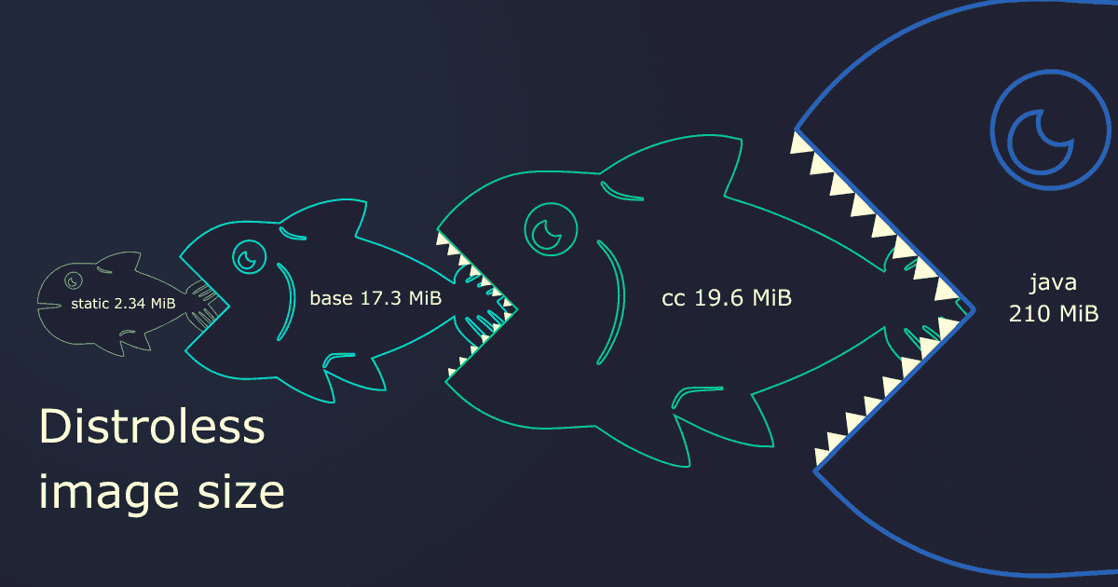
Size is relative
Notes:
To understand what makes Alpine a bad choice in some situations, we first need to talk about musl. musl is an implementation of C standard library. It is more lightweight, faster, and simpler than glibc used by other Linux distros, such as Ubuntu. Both of these implementations are interchangeable for the most part, that's why in most cases, you can switch from, e.g., Ubuntu to Alpine and never notice any difference.
However, the little differences can cause all the grief. Some of it stems from how musl (and therefore also Alpine) handles DNS (it's always DNS), more specifically, musl (by design) doesn't support DNS-over-TCP. Usually, you would not notice this difference because most of the time, a single UDP packet (512 bytes) is enough to resolve hostnames... until it isn't enough, and your application (running on Kubernetes) that previously worked completely fine for months suddenly starts throwing "Unknown Host" exceptions for one particular (very critical) hostname.
The worst part is that this can manifest randomly, anytime when some external network change causes the resolution of some particular domain to require more than the 512 bytes available in a single UDP packet.

Slide 29
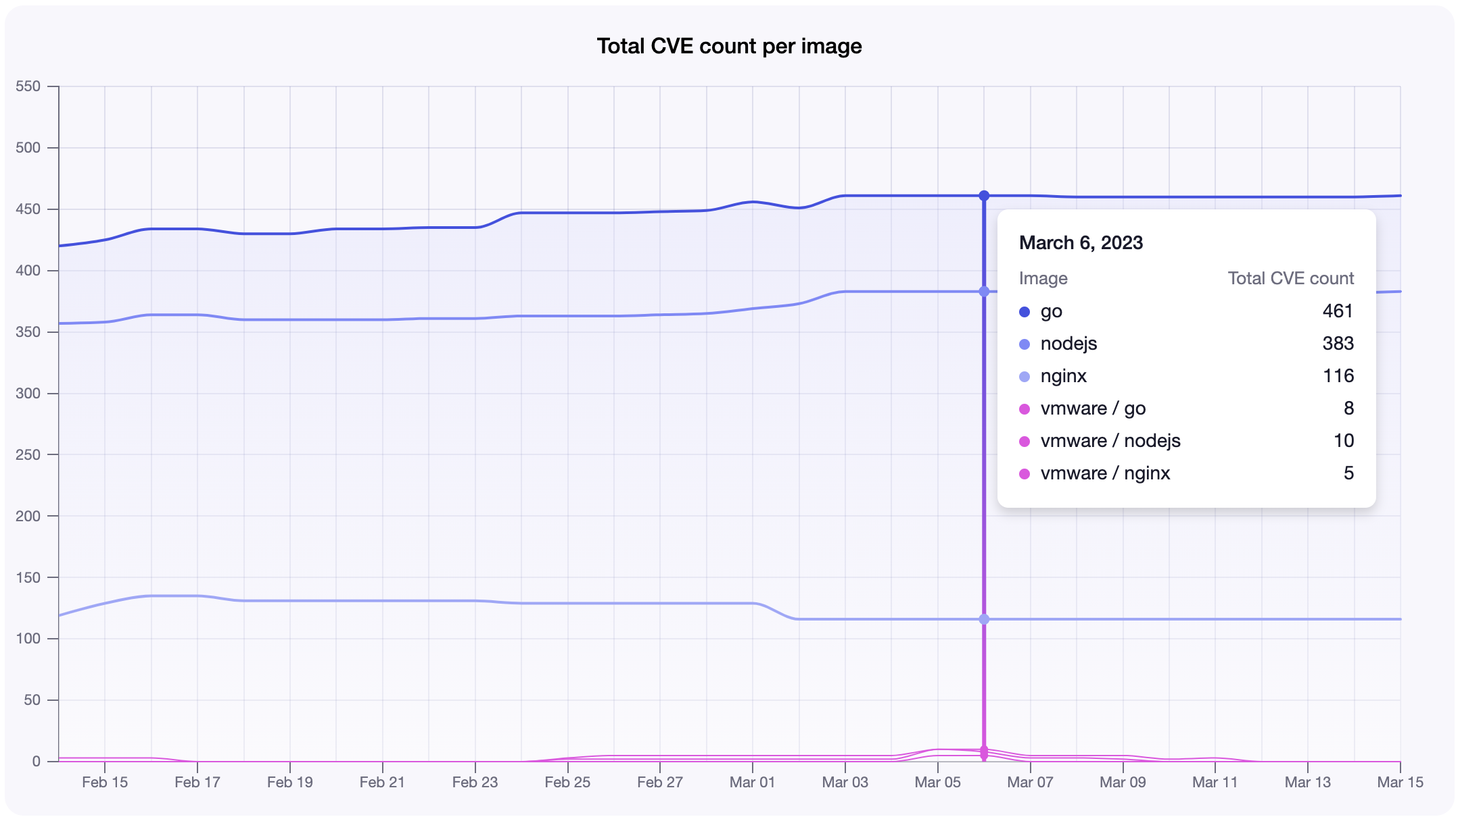

Notes:
To understand what makes Alpine a bad choice in some situations, we first need to talk about musl. musl is an implementation of C standard library. It is more lightweight, faster, and simpler than glibc used by other Linux distros, such as Ubuntu. Both of these implementations are interchangeable for the most part, that's why in most cases, you can switch from, e.g., Ubuntu to Alpine and never notice any difference.
However, the little differences can cause all the grief. Some of it stems from how musl (and therefore also Alpine) handles DNS (it's always DNS), more specifically, musl (by design) doesn't support DNS-over-TCP. Usually, you would not notice this difference because most of the time, a single UDP packet (512 bytes) is enough to resolve hostnames... until it isn't enough, and your application (running on Kubernetes) that previously worked completely fine for months suddenly starts throwing "Unknown Host" exceptions for one particular (very critical) hostname.
The worst part is that this can manifest randomly, anytime when some external network change causes the resolution of some particular domain to require more than the 512 bytes available in a single UDP packet.

Slide 30
insight
Symbiosis between package managers. Support for multiple package managers repository
Ditched “Dockerfiles” and switched to YAML
Plan to save a lot of $$$ as we have invested in reducing our COGS (cloud bill) and technical-debt
Far more secure-oriented approach, flexible build and dynamic images
Notes:
To understand what makes Alpine a bad choice in some situations, we first need to talk about musl. musl is an implementation of C standard library. It is more lightweight, faster, and simpler than glibc used by other Linux distros, such as Ubuntu. Both of these implementations are interchangeable for the most part, that's why in most cases, you can switch from, e.g., Ubuntu to Alpine and never notice any difference.
However, the little differences can cause all the grief. Some of it stems from how musl (and therefore also Alpine) handles DNS (it's always DNS), more specifically, musl (by design) doesn't support DNS-over-TCP. Usually, you would not notice this difference because most of the time, a single UDP packet (512 bytes) is enough to resolve hostnames... until it isn't enough, and your application (running on Kubernetes) that previously worked completely fine for months suddenly starts throwing "Unknown Host" exceptions for one particular (very critical) hostname.
The worst part is that this can manifest randomly, anytime when some external network change causes the resolution of some particular domain to require more than the 512 bytes available in a single UDP packet.

Slide 31
06
Project Myklon
New way to build distroless images

Slide 32
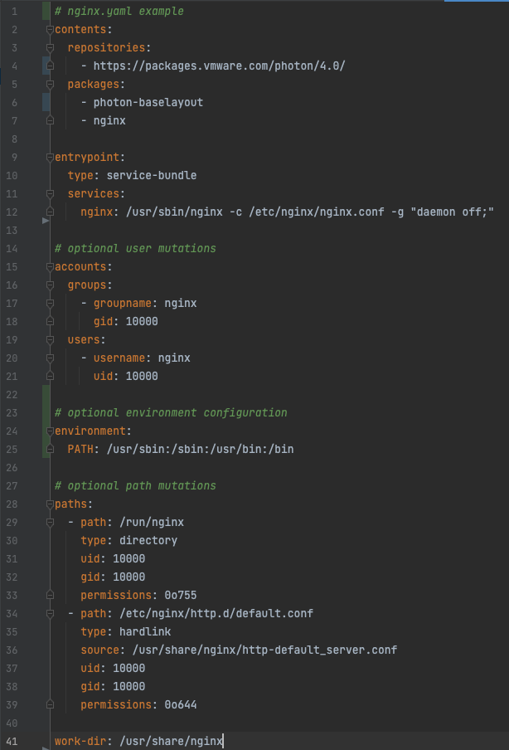
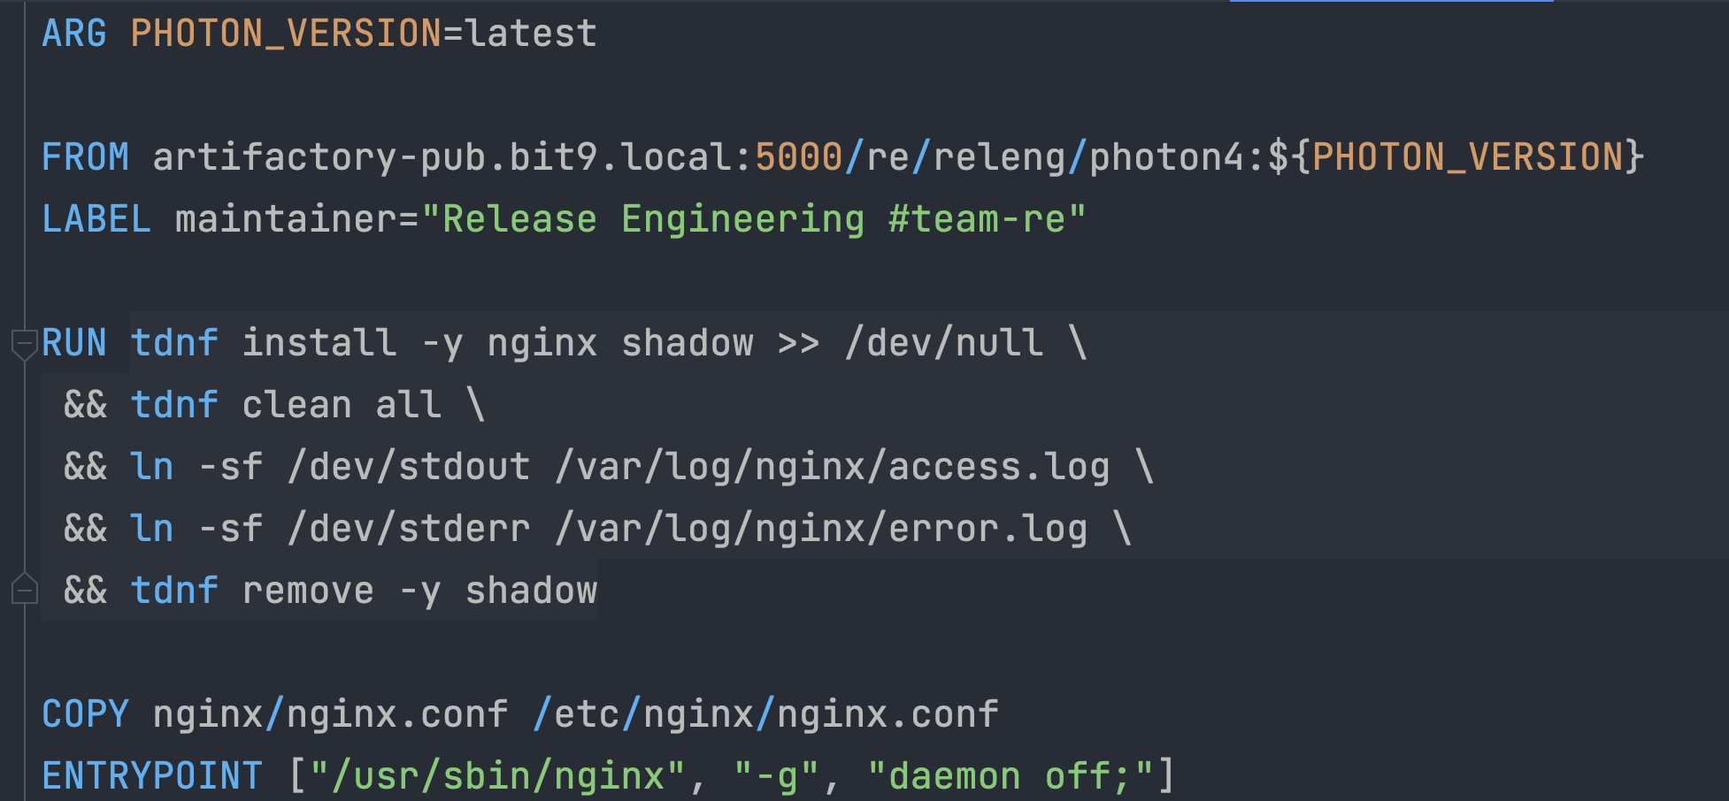
Dockerfiles are in the past
Notes:
To understand what makes Alpine a bad choice in some situations, we first need to talk about musl. musl is an implementation of C standard library. It is more lightweight, faster, and simpler than glibc used by other Linux distros, such as Ubuntu. Both of these implementations are interchangeable for the most part, that's why in most cases, you can switch from, e.g., Ubuntu to Alpine and never notice any difference.
However, the little differences can cause all the grief. Some of it stems from how musl (and therefore also Alpine) handles DNS (it's always DNS), more specifically, musl (by design) doesn't support DNS-over-TCP. Usually, you would not notice this difference because most of the time, a single UDP packet (512 bytes) is enough to resolve hostnames... until it isn't enough, and your application (running on Kubernetes) that previously worked completely fine for months suddenly starts throwing "Unknown Host" exceptions for one particular (very critical) hostname.
The worst part is that this can manifest randomly, anytime when some external network change causes the resolution of some particular domain to require more than the 512 bytes available in a single UDP packet.

Slide 33


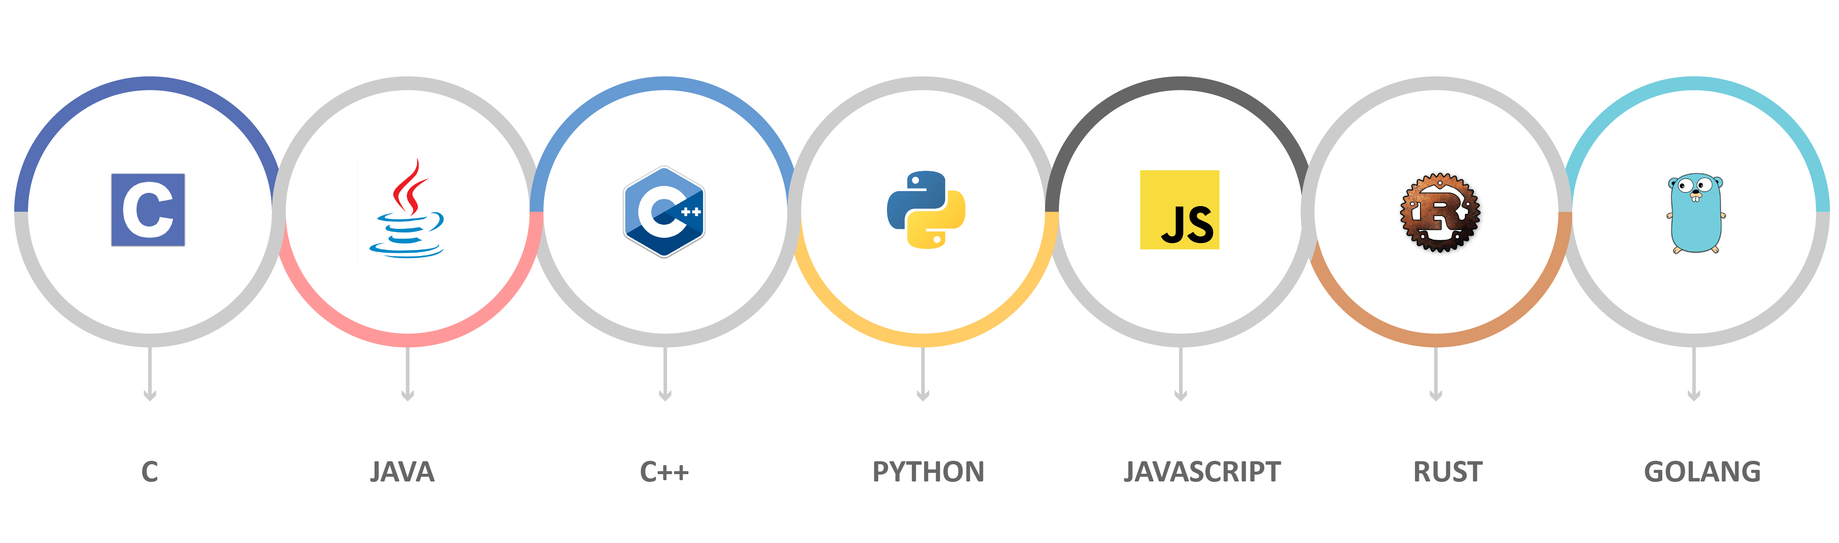
Notes:
To understand what makes Alpine a bad choice in some situations, we first need to talk about musl. musl is an implementation of C standard library. It is more lightweight, faster, and simpler than glibc used by other Linux distros, such as Ubuntu. Both of these implementations are interchangeable for the most part, that's why in most cases, you can switch from, e.g., Ubuntu to Alpine and never notice any difference.
However, the little differences can cause all the grief. Some of it stems from how musl (and therefore also Alpine) handles DNS (it's always DNS), more specifically, musl (by design) doesn't support DNS-over-TCP. Usually, you would not notice this difference because most of the time, a single UDP packet (512 bytes) is enough to resolve hostnames... until it isn't enough, and your application (running on Kubernetes) that previously worked completely fine for months suddenly starts throwing "Unknown Host" exceptions for one particular (very critical) hostname.
The worst part is that this can manifest randomly, anytime when some external network change causes the resolution of some particular domain to require more than the 512 bytes available in a single UDP packet.

Slide 34

Myklon flow
Project Myklon uses ko (https://github.com/ko-build/ko) to produce a tar.gz consumed by CRI
Separate streams: build & runtime (run)
Buildpacks feeds what needs to be added as packages
Each package is broken down to capabilities through capability-match matrix
End result is an image minimum in size, easily-build and easily maintainable
You don’t need Container Registry (Artifactory, Nexus, Hub etc.) – runtime
build
run
Notes:
To understand what makes Alpine a bad choice in some situations, we first need to talk about musl. musl is an implementation of C standard library. It is more lightweight, faster, and simpler than glibc used by other Linux distros, such as Ubuntu. Both of these implementations are interchangeable for the most part, that's why in most cases, you can switch from, e.g., Ubuntu to Alpine and never notice any difference.
However, the little differences can cause all the grief. Some of it stems from how musl (and therefore also Alpine) handles DNS (it's always DNS), more specifically, musl (by design) doesn't support DNS-over-TCP. Usually, you would not notice this difference because most of the time, a single UDP packet (512 bytes) is enough to resolve hostnames... until it isn't enough, and your application (running on Kubernetes) that previously worked completely fine for months suddenly starts throwing "Unknown Host" exceptions for one particular (very critical) hostname.
The worst part is that this can manifest randomly, anytime when some external network change causes the resolution of some particular domain to require more than the 512 bytes available in a single UDP packet.

Slide 35
Myklon CI/CD
Repositories cross-reference centralized repository. Execute child-job prior build.
A reproducable YAML-spec is created for the required image for that specific repository
It consist of two YAML file specification – one for build and one for runtime
All images are signed with timestamp and build on-the-fly. No artifact storage, no ECR
Image size is drastically lower – nginx 56mb → 3.8mb
Any k8s definition (yaml) image can be fed with reference to yaml-file with timestamp
Notes:
To understand what makes Alpine a bad choice in some situations, we first need to talk about musl. musl is an implementation of C standard library. It is more lightweight, faster, and simpler than glibc used by other Linux distros, such as Ubuntu. Both of these implementations are interchangeable for the most part, that's why in most cases, you can switch from, e.g., Ubuntu to Alpine and never notice any difference.
However, the little differences can cause all the grief. Some of it stems from how musl (and therefore also Alpine) handles DNS (it's always DNS), more specifically, musl (by design) doesn't support DNS-over-TCP. Usually, you would not notice this difference because most of the time, a single UDP packet (512 bytes) is enough to resolve hostnames... until it isn't enough, and your application (running on Kubernetes) that previously worked completely fine for months suddenly starts throwing "Unknown Host" exceptions for one particular (very critical) hostname.
The worst part is that this can manifest randomly, anytime when some external network change causes the resolution of some particular domain to require more than the 512 bytes available in a single UDP packet.

Slide 36
THANKS!
DO YOU HAVE ANY QUESTIONS?
vbonev@vmware.com
Viktor Bonev

